Slide 1
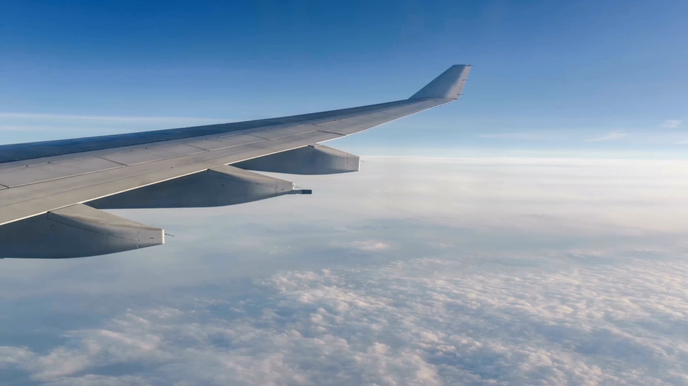
Flight Customer Management System
Group No. 2
The Supa Strikers
Meetul Agrawal Anurag Saxena Jinal Patel
Manish Sharma Sakshi Thekdi Chirag Malhotra

Slide 2

Agenda: 1. Introduction 2. SQL Features 3. Metadata 4. Why Chose Topic 5. Queries

Slide 3

Introduction:
Flight Customer Management refers to the comprehensive set of strategies, processes, and technologies that airlines employ to interact with and serve their passengers throughout the entire travel journey. It encompasses reservations, check-in, baggage handling, passenger communication, and more.

Slide 4
SQL Features
Subqueries
Aggregation Function
Group by
Order by
Limit
String Function
Case

Slide 5
Metadata
CustomerID –
A unique identifier for customers (varchar).
First_name –
First name of the customer (char).
Last_name –
Last name of the customer (char).
Mobile –
Customer's mobile number (varchar).
Gender –
Customer's gender (char).
Age –
Customer's age (int).
Departure –
Departure location or city (char).
Arrival –
Arrival location or city (char).
Departure_date –
Date of departure (date).
Arrival_date –
Date of arrival (date).
Departure_time –
Time of departure (time).
Arrival_time –
Time of arrival (time).
Class –
Flight class or category (char).
Flight_no –
Flight number (int).
Fare –
Fare for the flight (int).
Checkin_luggage –
Luggage allowance for check-in (char).
Cabin_luggage –
Cabin luggage allowance (char).
Plane_model –
Model of the plane (int).
Capacity –
Maximum capacity of the plane (int).
Plane_registration_no –
Registration number of the plane (varchar)

Slide 6

Why chose this Topic
1. Relevance to learning goals
2. Real World Application

Slide 7
Queries

Slide 8
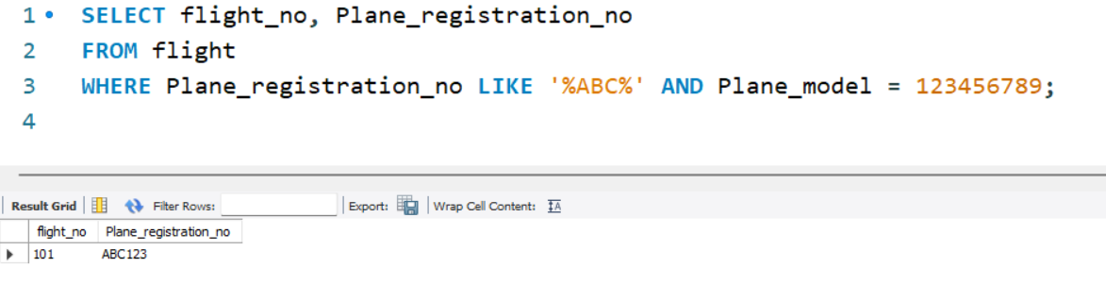
Select flights where the plane registration number contains 'ABC' and the plane model is '123456789'

Slide 9
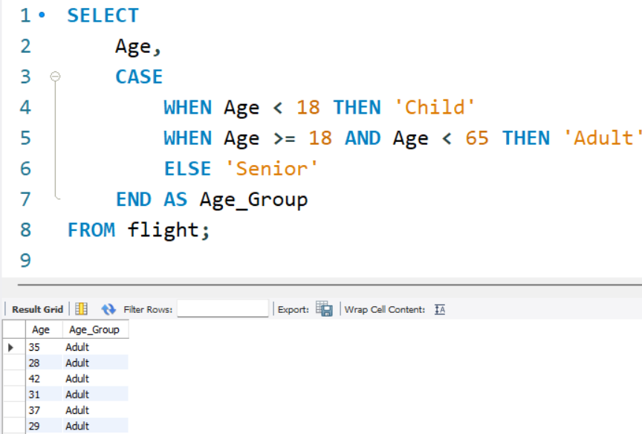
Categorize age groups

Slide 10
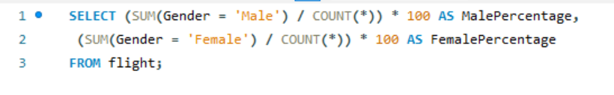
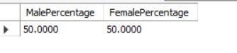
count percentage of male and female

Slide 11
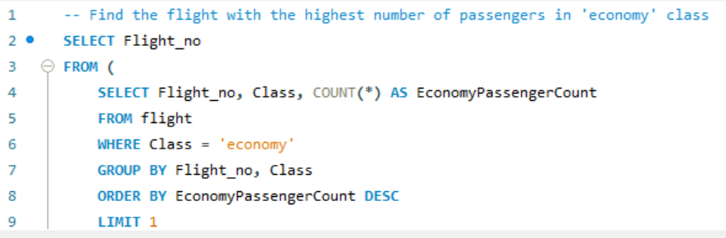
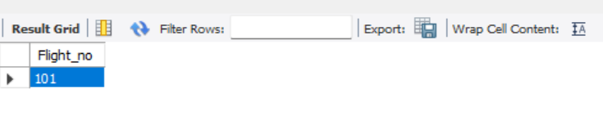
Select the flight with the highest number of passengers traveling in 'economy' class

Slide 12
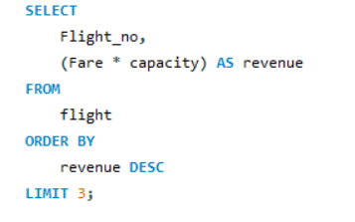
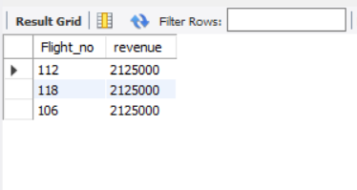
Select the top 3 flights with the highest revenue (fare * capacity)

Slide 13
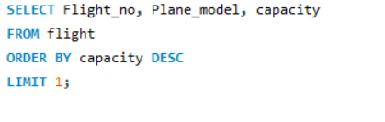
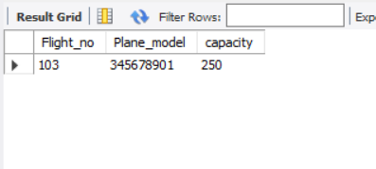
Select the flight with the highest plane capacity and its plane model

Slide 14
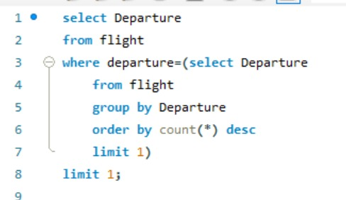
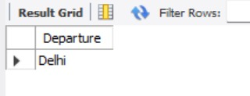
Select flights with the most common departure location

Slide 15
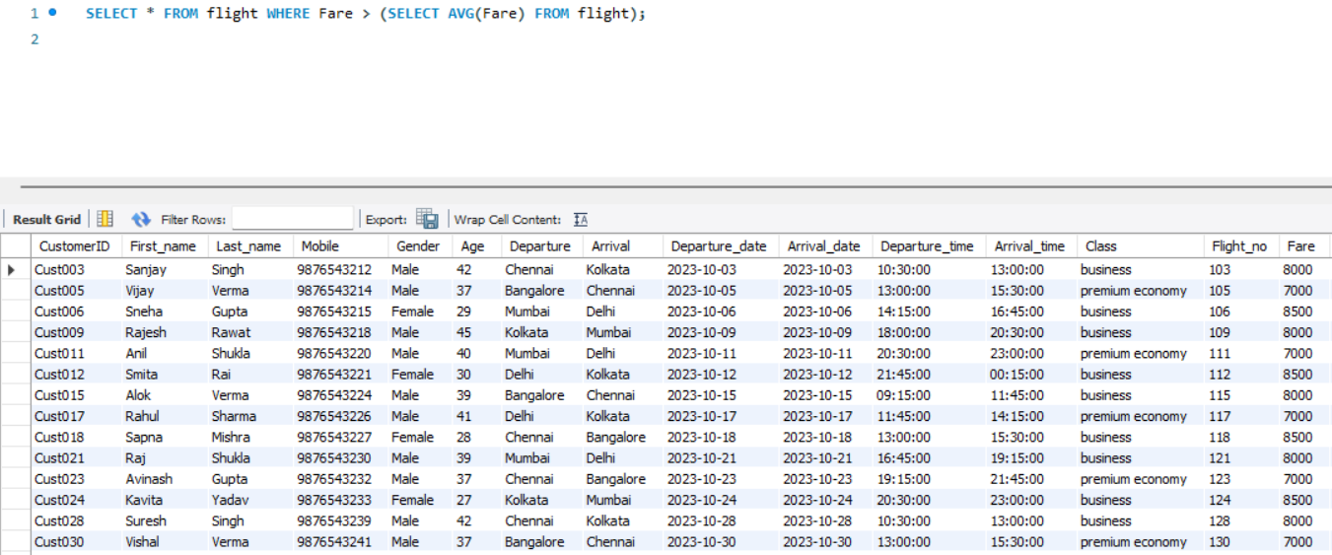
Select flights with a fare greater than the average fare

Slide 16
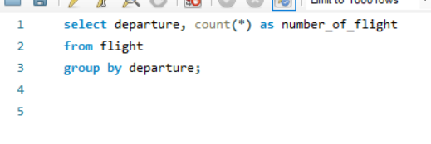
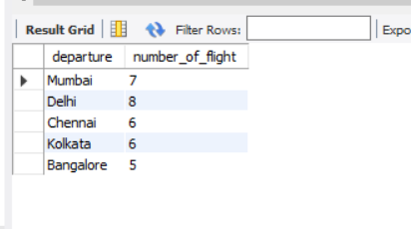
Select the number of flights for each departure location

Slide 17
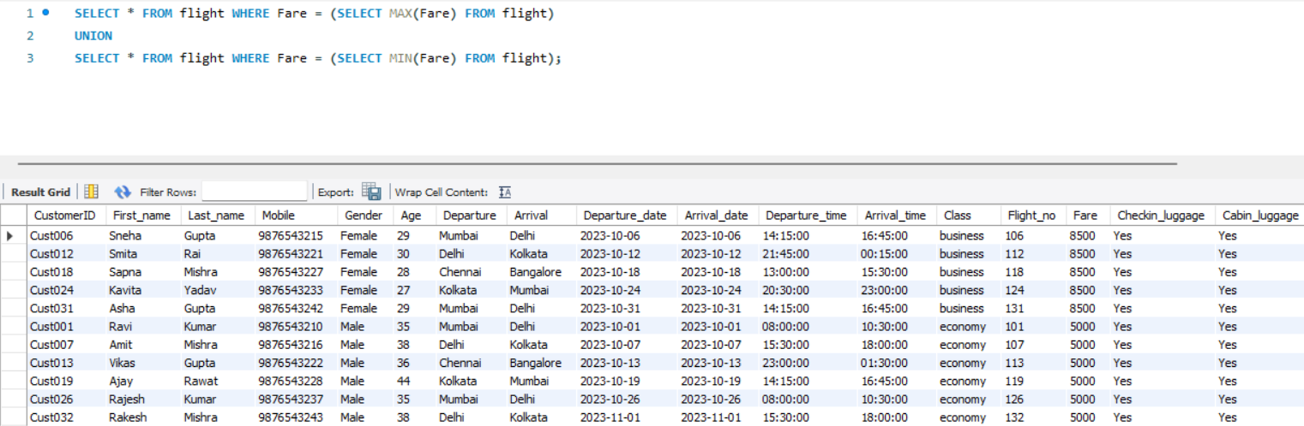
Select the flight with the highest fare and the flight with the lowest fare

Slide 18
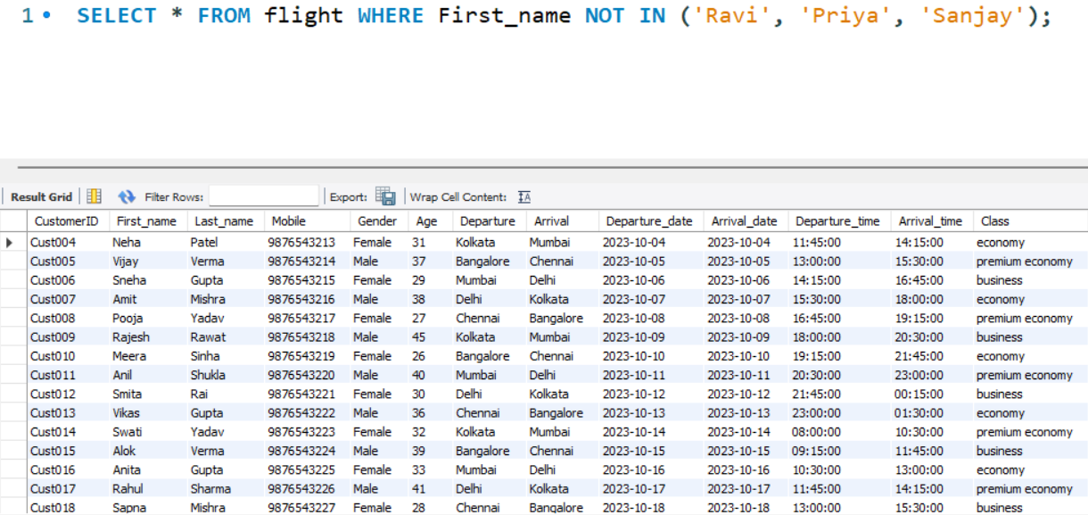
Select flights with customers whose first names are not in the list ('Ravi', 'Priya', 'Sanjay')

Slide 19
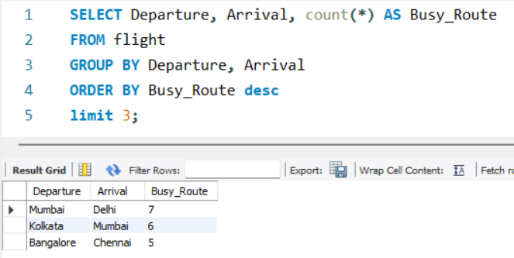
Select the top 3 busiest routes (departure to arrival) based on the total number of flights.

Slide 20
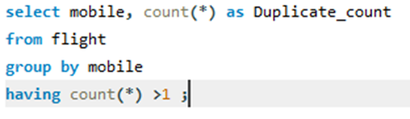
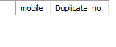
Find customer duplicate mobile no.

Slide 21
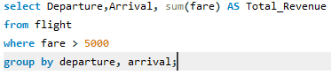
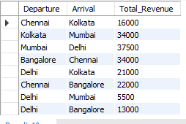
Calculate the total revenue for each departure location and arrival location combination (route) for flights with fares greater than 5000.

Slide 22
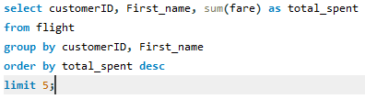
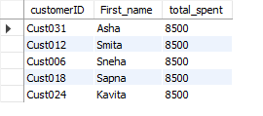
Find the top 5 customers who have spent the most on flights (based on total fare

Slide 23
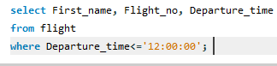
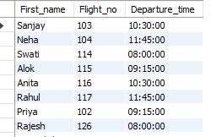
Select flights with departure times in the morning (before 12:00 PM)

Slide 24
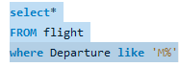
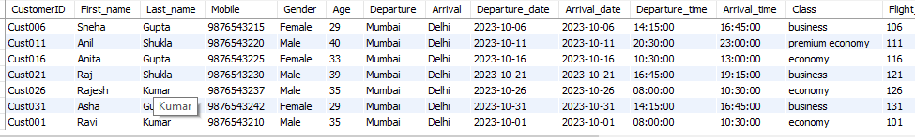
Select flights with departure locations starting with 'M'

Slide 25
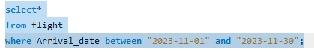
Select flights where arrival dates are in November 2023

Slide 26
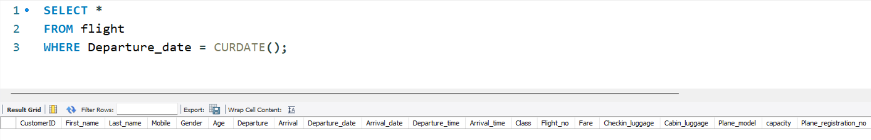
Select flights where the departure date is the same as the current date

Slide 27

CONCLUSION

Slide 28

Thank You

